Slide 1
Carnegie Mellon
Computer Systems Organization
https://nyu-cso.github.io
Jinyang Li

Slide 2
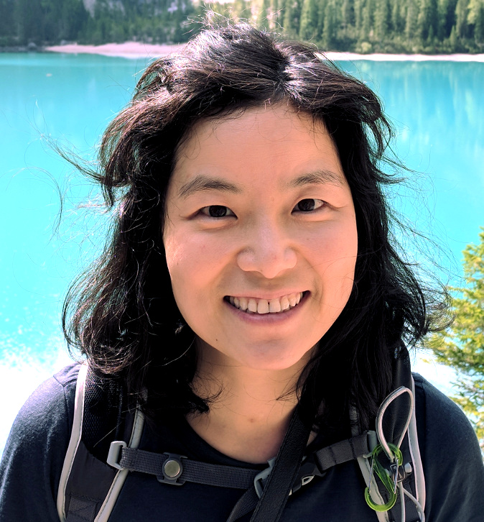
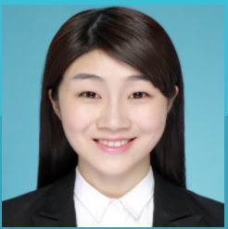

Carnegie Mellon
Course staff
Lecturer: Prof. Jinyang Li
Zoom recitation instructor:
Anqi Zhang (PhD student)
In-person recitation instructor:
Arahant Ashok Kumar (M.S. student)

Slide 3
Zoom lecture
Recorded.
You are muted by default.
For questions, type in (public) chat or raise hands
Anqi will monitor chat box / hand raising and interrupt me for Q&A.
I will randomly select specific students to answer questions.
You’ll be unmuted and have video turned on
part of participation
grade

Slide 4

Course Goal
Beyond learning how to program
Learn the gritty internals of how a computer really works
How does the ring really work?

Slide 5
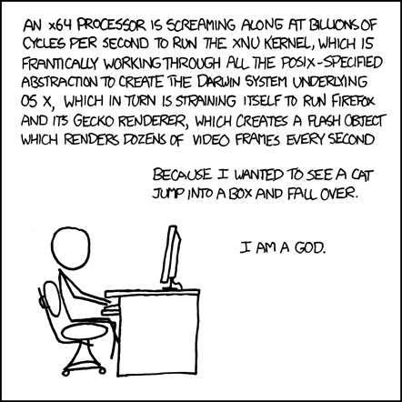
Covered
by CSO
To be covered
by OS (202)
and a bunch
of other stuff

Slide 6
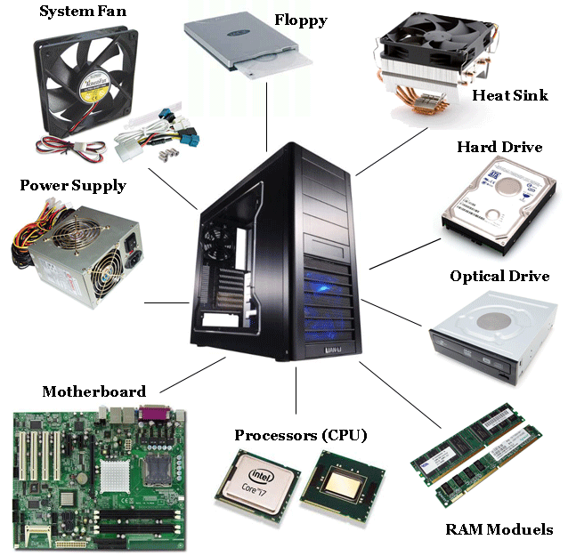
Components of a computer: hardware

Slide 7
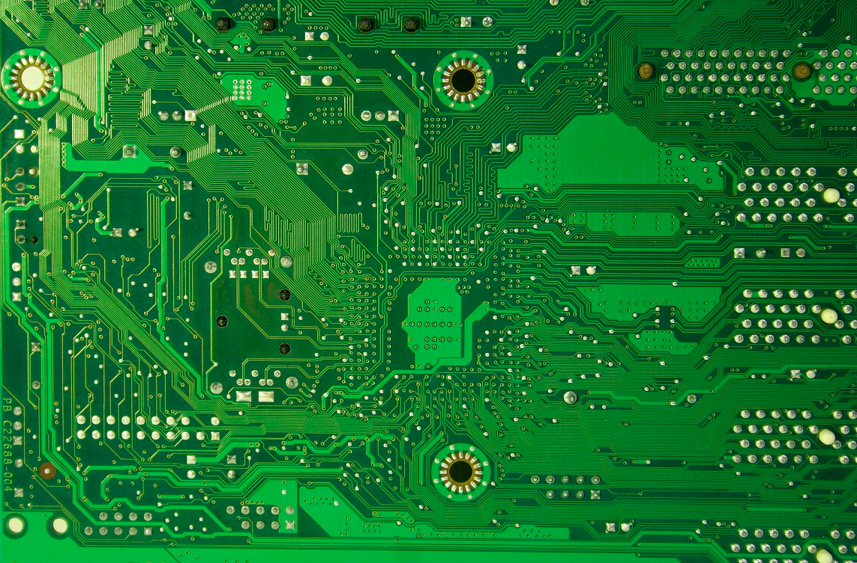

Components of a computer: hardware
Printed Circuit

Slide 8

Components of a computer: hardware + software
Printed Circuit

Slide 9
Layered Organization
Software
Hardware

Slide 10
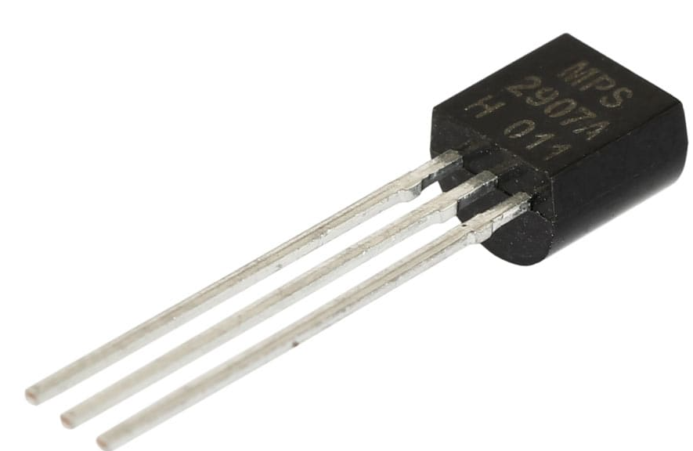
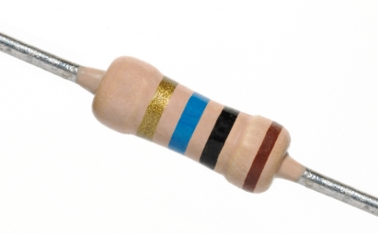

Layered Organization
Software
Hardware
Transistors
Diodes
Resistors

Slide 11
Layered Organization
Software
Hardware
Logical Circuits,
Flip-Flops, Gates
Transistors
Diodes
Resistors

Slide 12
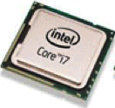
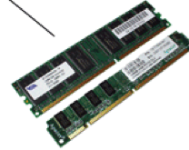
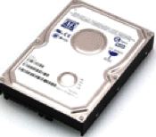
Layered Organization
Software
Hardware
CPU, Memory, Disk
Logical Circuits,
Flip-Flops, Gates
Transistors
Diodes
Resistors

Slide 13
Layered Organization
Software
Hardware
CPU
Memory
I/O
Logical Circuits, Flip-Flops, Gates, …
Transistors, Diodes, Resistors, …

Slide 14







Layered Organization
System Software
(OS, compiler, VM…)
Software
Hardware
CPU
Memory
I/O
Logical Circuits, Flip-Flops, Gates, …
Transistors, Diodes, Resistors, …

Slide 15






Layered Organization
User Applications
System Software
(OS, compiler, VM…)
Software
Hardware
CPU
Memory
I/O
Logical Circuits, Flip-Flops, Gates, …
Transistors, Diodes, Resistors, …

Slide 16

Layered Organization
Users
User Applications
System Software
(OS, compiler, VM…)
Software
Hardware
CPU
Memory
I/O
Logical Circuits, Flip-Flops, Gates, …
Transistors, Diodes, Resistors, …

Slide 17
Layered Organization
User Applications
Apps
System Software
Operating System
Software
Hardware
CPU
Memory
I/O
Logical Circuits, Flip-Flops, Gates, …
Transistors, Diodes, Resistors, …

Slide 18
Abstraction
User Applications
Apps
System Software
Operating System
Software
Hardware
CPU
Memory
I/O
Abstract Interface
Logical Circuits, Flip-Flops, Gates, …
Transistors, Diodes, Resistors, …

Slide 19
Scope of this class
User Applications
Apps
System Software
Operating System
Software
Hardware
CPU
Memory
I/O
Abstract Interface
Logical Circuits, Flip-Flops, Gates, …
Transistors, Diodes, Resistors, …

Slide 20
Scope of this class
How do applications run on a computer?
Hardware/software interface
How do CPU/memory work?
overview of computer architecture
New!

Slide 21
Schedule
https://nyu-cso.github.io
C Programming
overview
bit, byte and int
float point
[C] basics, bitwise operator, control flow
[C] scopes rules, pointers, arrays
[C] structs, mallocs
[C] large program (linked list)

Slide 22
Schedule
https://nyu-cso.github.io
C Programming
overview
bit, byte and int
float point
[C] basics, bitwise operator, control flow
[C] scopes rules, pointers, arrays
[C] structs, mallocs
[C] large program (linked list)
Machine Prog: ISA, Compile, movq
Machine Prog: Control Code (condition, jump instruction)
Machine Prog: Array allocation and access
Machine Prog: Procedure calls
Machine Prog: Structure, Memory Layout
Machine Prog: Buffer Overflow
Assembly (X86)

Slide 23
Schedule
https://nyu-cso.github.io
C Programming
overview
bit, byte and int
float point
[C] basics, bitwise operator, control flow
[C] scopes rules, pointers, arrays
[C] structs, mallocs
[C] large program (linked list)
Machine Prog: ISA, Compile, movq
Machine Prog: Control Code (condition, jump instruction)
Machine Prog: Array allocation and access
Machine Prog: Procedure calls
Machine Prog: Structure, Memory Layout
Machine Prog: Buffer Overflow
Code optimizations
Dynamic Memory Allocation
Dynamic Memory Allocation continued
Assembly (X86)
Dynamic Memory
Allocation

Slide 24
Schedule
https://nyu-cso.github.io
overview
bit, byte and int
float point
[C] basics, bitwise operator, control flow
[C] scopes rules, pointers, arrays
[C] structs, mallocs
[C] large program (linked list)
Machine Prog: ISA, Compile, movq
Machine Prog: Control Code (condition, jump instruction)
Machine Prog: Array allocation and access
Machine Prog: Procedure calls
Machine Prog: Structure, Memory Layout
Machine Prog: Buffer Overflow
Code optimizations
Dynamic Memory Allocation
Dynamic Memory Allocation continued
Logic Design
Logic Design continued
Sequential implementation
Pipelined implementation
C Programming
Assembly (X86)
Dynamic Memory
Allocation
Architecture

Slide 25
Schedule
https://nyu-cso.github.io
C Programming
overview
bit, byte and int
float point
[C] basics, bitwise operator, control flow
[C] scopes rules, pointers, arrays
[C] structs, mallocs
[C] large program (linked list)
Machine Prog: ISA, Compile, movq
Machine Prog: Control Code (condition, jump instruction)
Machine Prog: Array allocation and access
Machine Prog: Procedure calls
Machine Prog: Structure, Memory Layout
Machine Prog: Buffer Overflow
Code optimizations
Virtual memory: Address Spaces/ Translation, Goal
Virtual memory: Page table/physcial to virtual
Process
Dynamic Memory Allocation I: malloc, free
Dynamic Memory Allocation II: design allocator
Dynamic Memory Allocation III: futher optimization
Memory, cache
Memory, cache
Assembly (X86)
Dynamic Memory
Allocation
Architecture
Memory & Cache

Slide 26
Breakout activity
You’ll be assigned to a breakout room
12 minutes
TODO:
Introduce oneself to each other
Nominate a group leader
Complete the given Google form as a group.
Only leader should submit the form

Slide 27
Course structure
Zoom Lectures: M/W 12:30-1:45pm
Zoom Recitation: R 8-9:15am
All must attend.
Recorded.
(Optional) In-person recitation: W 11am-12:15pm
Only for students registered for CSCI-UA.0201-​010
Content is in addition to those in Zoom recitation.
Not recorded.
Starts tomorrow

Slide 28
Course websites
Main website: https://nyu-cso.github.io
Syllabus
Reading preparation
lecture/recitation slides
Lab instructions
Forum: https://campuswire.com/c/G4A62FCF2
Q&A
NYU-classes
Zoom links, Zoom recordings
Gradescope
Lab submission, weekly assessments
Use Campuswire instead of NYU-classes for Q&A.

Slide 29
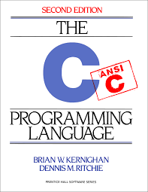
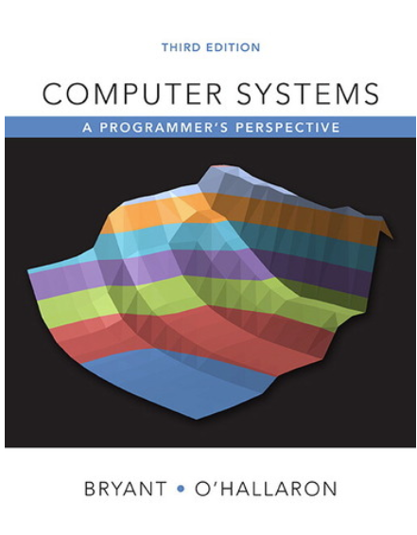

Textbooks
The C Programming Language 2nd ed,
Kernighan and Ritchie
Computer Systems -- A programmer's perspective, 3rd ed, Bryant and O’Hallaron.
Computer organization and design (RISC-V edition), Patterson and Hennessy

Slide 30
Grade Breakdown
6 programming labs
Lab-1,2,3: 8%
Lab-4,5,6: 9%
Weekly assessment
14 total, starting next week
3% each
Participation: 7%
Includes participation in lecture, recitation, online forum (Campuswire)

Slide 31
6 individual programming labs
Programming environment:
Virtual machine running on your laptop
Learn to use:
a text editor to write code
git for version control
Optional bonus exercises.
Submission:
Push to github
Submit and have it graded via Gradescope
Late policy:
6 (cumulative) grace days in total over the semester.
3 max. grace days for each lab.

Slide 32
Weekly assessment (mini-quiz)
Starting next week
Done via Gradescope:
Multiple choice questions and short answers
Mostly on the current week’s materials
Open-book individual assessments
Do not consult your classmates or anyone else.
Quiz duration:
24-hours.
Thu 9pm to Fri 9pm (EST). No late submission.
Answered discussed in the following week’s zoom recitation

Slide 33
To do well in CSO, you should …
Before lecture:
Read assigned book chapters before lecture
Duration lecture/recitation:
Ask me to repeat, repeat and repeat
Ask questions
Answer questions from me or others
Befriend your classmates and form study groups

Slide 34
To survive/thrive in CSO, you should …
Before lecture:
Read assigned book chapters
During lecture/recitation:
Ask questions
Don’t be shy to ask me to repeat.
Labs and weekly assessment.
Start early
Getting help:
Campuswire
Office hours (TBA later this week)

Slide 35
Integrity and Collaboration Policy
Carnegie Mellon
The work that you turn in must be yours
You must acknowledge your influences
E.g., if you are inspired by a code snippet, include the URL to the snippet in the lab you turn in.
You must not look at, or use, solutions from prior years or the Web, or seek assistance from the Internet
You must take reasonable steps to protect your work
You must not publish your solutions
We reserve the right to randomly pick students for oral assessment and over-weight oral assessment if it does not match your quiz/lab performance.

Slide 36
Integrity and Collaboration Policy
Carnegie Mellon
We will enforce integrity policy strictly and report violators to the department and Dean.
Do not turn in labs/quiz that are not yours
You won’t fail because of one missing lab/quiz

